Slide 1
Threads and Processes
Most operating systems therefore support two entities:
  the process,
    which defines the address space and general process attributes
  the thread,
    which defines a sequential execution stream within a process
A thread is bound to a single process.
  For each process, however, there may be many threads.
Threads are the unit of scheduling
Processes are containers in which threads execute

Slide 2

Single and Multithreaded Processes

Slide 3

Motivation for multi-threaded servers

Slide 4
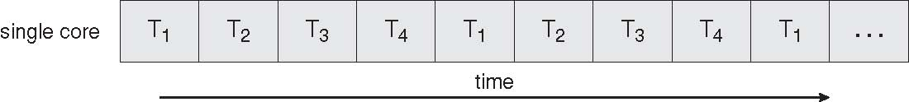
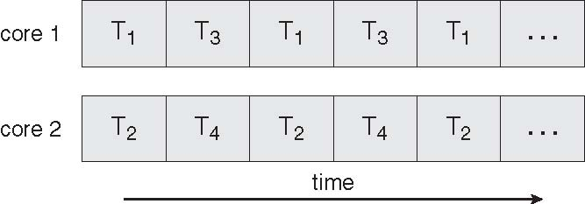
Benefits
Responsiveness
Resource Sharing
Economy
Scalability

Slide 5
Distinguishing Threads and Processes
Makes it easier to support multithreaded applications
  Different from multiprocessing, multiprogramming, multitasking
Concurrency (multithreading) is useful for:
  improving program structure
  Improving responsiveness
  handling concurrent events (e.g., web requests)
  building parallel programs
  sharing resources economically
  multiprocessor utilization
Is multithreading useful even on a single processor?

Slide 6
Threads vs. Processes
A thread has no data segment or heap
A thread cannot live on its own, it must live within a process
There can be more than one thread in a process, the first thread calls main & has the process’s stack
Inexpensive creation
Inexpensive context switching
If a thread dies, its stack is reclaimed
A process has code/data/heap & other segments
A process has at least one thread
Threads within a process share code/data/heap, share I/O, but each has its own stack & registers
Expensive creation
Expensive context switching
If a process dies, its resources are reclaimed & all threads die

Slide 7
User and Kernel Threads
User threads - Thread management done by user-level threads library, with or without knowledge of the kernel
Kernel threads - Threads directly supported by the kernel:
  Windows XP/2000
  Solaris
  Linux
  Tru64 UNIX
  Mac OS X

Slide 8
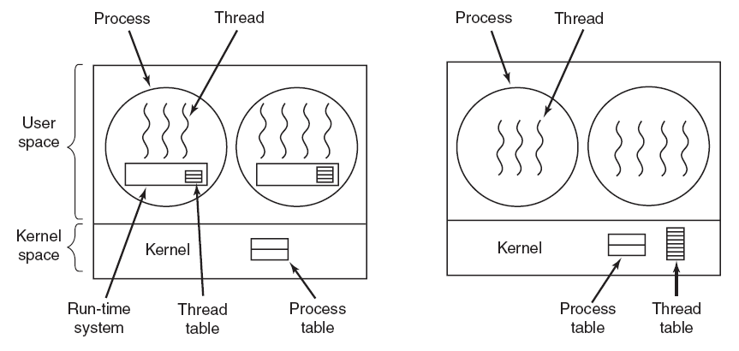
User vs. Kernel Threads
(a) A user-level threads package. (b) A threads package managed by the kernel.
Example from Tanenbaum, Modern Operating Systems 3 e,
(c) 2008 Prentice-Hall, Inc. All rights reserved. 0-13-6006639

Slide 9
Kernel Threads
Also called Lightweight Processes (LWP)
Kernel threads still suffer from performance problems
Operations on kernel threads are slow because:
  a thread operation still requires a system call
  kernel threads may be overly general
    to support needs of different users, languages, etc.
  the kernel doesn’t trust the user
    there must be lots of checking on kernel calls

Slide 10
User-Level Threads
For speed, implement threads at the user level
A user-level thread is managed by the run-time system
  user-level code that is linked with your program
Each thread is represented simply by:
  PC
  Registers
  Stack
  Small control block
All thread operations are at the user-level:
  Creating a new thread
  switching between threads
  synchronizing between threads

Slide 11
User-Level Threads
User-level threads
  the thread scheduler is part of a library, outside the kernel
  thread context switching and scheduling is done by the library
  Can either use cooperative or pre-emptive threads
    cooperative threads are implemented by:
      CreateThread(), DestroyThread(), Yield(), Suspend(), etc.
    pre-emptive threads are implemented with a timer (signal)
      where the timer handler decides which thread to run next

Slide 12
User-Level vs. Kernel Threads
User-Level
Managed by application
Kernel not aware of thread
Context switching cheap
Can create many more
Must be used with care
Kernel-Level
Managed by kernel
Consumes kernel resources
Context switching expensive
Number limited by kernel resources
Simpler to use
Key issue: kernel threads provide virtual processors to user-level threads,
but if all of kernel threads block, then all user-level threads will
block even if the program logic allows them to proceed

Slide 13
Multiplexing User-Level Threads
The user-level thread package sees a “virtual” processor(s)
  it schedules user-level threads on these virtual processors
  each “virtual” processor is implemented by a kernel thread
The big picture:
  Create as many kernel threads as there are processors
  Create as many user-level threads as the application needs
  Multiplex user-level threads on top of the kernel-level threads
Why not just create as many kernel-level threads as app needs?
  Context switching
  Resources

Slide 14
Multithreading Models
Mapping user threads to kernel threads:
Many-to-One
One-to-One
Many-to-Many

Slide 15

Many-to-One
Many user-level threads mapped to single kernel thread
  Fast - no system calls required
  Few system dependencies; portable
  No parallel execution of threads - can’t exploit multiple CPUs
  All threads block when one uses synchronous I/O
Examples:
  Solaris Green Threads
  GNU Portable Threads

Slide 16

One-to-One
Each user-level thread maps to kernel thread
  More concurrency
  Better multiprocessor performance
  Each user thread requires creation of kernel thread
  Each thread requires kernel resources; limits number of total threads
Examples
  Windows NT/XP/2000
  Linux
  Solaris 9 and later

Slide 17

Many-to-Many Model
Allows many user level threads to be mapped to many kernel threads
  Allows the operating system to create a sufficient number of kernel threads
  If U < L, no benefits of multithreading
  If U > L, some threads may have to wait for an LWP to run
Examples:
  Solaris prior to version 9
  Windows NT/2000 with the ThreadFiber package

Slide 18

Two-level Model
Similar to M:M, except that a user thread may be bound to kernel thread
Examples
  IRIX
  HP-UX
  Tru64 UNIX
  Solaris 8 and earlier

